Slide 1
Marketplace Revenue Leakage & Gap Analysis using SQL

Slide 2

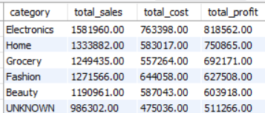
Task 1 - Revenue vs Profit Reality
The business is clearly profitable and not just generating sales.
Profit is 52.6% of revenue
Cost is only 47.4% of revenue
This means:
Strong pricing power
Healthy margins
Good cost control
Task 2 - Category-wise Sales & Profit
1) Categories that truly contribute to business success: Electronics, Home,
Grocery
2) Categories with high sales but low profit: Fashion, Unknown
3) Categories with lower sales but strong margins: Beauty

Slide 3
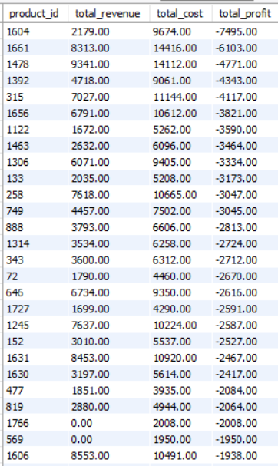
Task 3 - Loss-Making Products
Severe Loss Contributors (High Revenue, Even Higher Cost) like product 1661, 1478
These products are selling well but still losing money
Indicates:
Pricing is too low
Cost price is too high
Action:
Immediate repricing
Supplier negotiation (reduce cost)
Check if heavy discounting is applied

Slide 4

Task 4 - Discount Usage Overview
1. Discounts are used frequently (not occasional)
898 discounted orders indicate that a significant portion of transactions rely on discounts
This suggests discounts are not just promotional, but likely part of the core sales strategy
2. High total discount value → Aggressive discounting
6.7L+ in discounts is substantial
Indicates the business is giving away a large portion of potential revenue

Slide 5
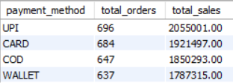

Task 5 - Payment Method Popularity
Digital payments dominate (UPI + Card)
Promote UPI as primary payment method
Use card offers for premium customers
Gradually reduce COD dependency
Boost wallet adoption via incentives
Task 6 - Discount vs Profit Gap
Profit drops significantly when discounts are applied
This clearly shows discounts are reducing margins, not improving profitability
Discounts may be increasing number of orders (volume), but destroying per-order profitability

Slide 6

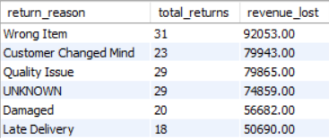
Task 7 - Return Impact on Revenue
1. Significant Revenue Reversal
A loss of 434K revenue indicates a high volume or high-value returns
This is not a minor issue — it’s a visible dent in topline performance
2. Major Profit Leakage
Profit loss is 228K, which is more than 50% of the revenue lost
This shows returns are not just reversing sales — they are directly eroding margins
Task 8 - Return Reason Analysis
Top 3 causes (Wrong Item, Quality Issue, Changed Mind) drive majority of losses
Many issues are preventable (operations + product quality)
“UNKNOWN” reason shows data quality gap

Slide 7
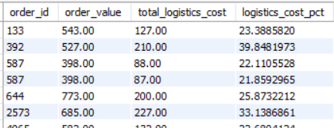
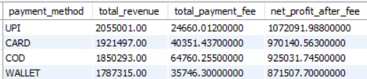
Task 9 - Logistics Cost Burden
High Logistics Cost % Across Orders
Many orders have logistics cost > 20%
Some even reach 30%–42%, which is very high
This indicates serious cost inefficiency in fulfillment
Task 10 - Payment Fee Leakage
UPI is the most cost-efficient and profitable payment method
Cards are popular but reduce margins due to high fees
COD is stable but not the most efficient option
Wallet payments are least efficient and highly cost-heavy

Slide 8
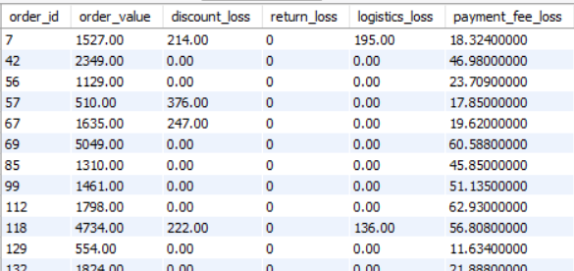
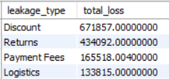
Task 11 - Revenue Leakage Breakdown
Highest loss due to Discount suggests over promotion
Second highest is due to Returns meaning high customer dissatisfaction due to product / delivery issue

Slide 9
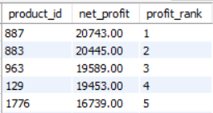
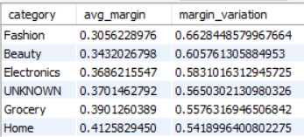
Task 12 - Product Profit Ranking
Highest profit providing product is 887 of category Home
Least profit providing product is 1656 of category Electronics
Task 13 - Category Margin Stability
High Variation Categories indicates
Inconsistent pricing
Different discounting strategies
Supplier cost fluctuations
Low Variation Categories
Stable and predictable margins
Easier to scale and forecast

Slide 10
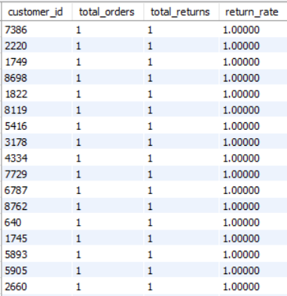
Task 14 - High-Risk Customers
High-Risk Customers
Possible reasons for frequently return orders
Misuse (wardrobing, abuse)
Poor product fit
Wrong expectations
Actions
Restrict return policy (for these users)
Limit COD or free returns
Provide better product recommendations

Slide 11
Task 15 - Executive Profitability Summary
Despite strong sales, profitability is reduced due to heavy discounting and high return losses, with additional impact from logistics and payment fees. The business must optimize promotions and reduce returns to improve margins.
Strategic Recommendations
Reduce blanket discounts → move to targeted offers
Fix return drivers → quality, description, delivery
Introduce minimum order value → control logistics
Promote low-fee payment methods (UPI, etc.)

Slide 12
Conclusion
The business is fundamentally strong in terms of revenue and base profitability, but actual profit is significantly impacted by operational and strategic leakages.
Profit is not low because of sales, but because of:
Excessive discounts
High return rates
Inefficient logistics
Payment fee leakage
Strategic Focus Areas:
Reduce Discount Dependency
Shift from blanket to targeted promotions
Control Returns
Improve product quality & delivery accuracy
Identify and restrict high-risk customers
Optimize Logistics
Introduce minimum order value
Improve delivery efficiency
Improve Payment Mix
Promote UPI
Reduce high-fee payment usage

